Slide 1



Leveraging Machine Learning for Sustainable Health: Predicting Chronic Diseases and Personalized Recommendations
The global burden of chronic diseases is a critical challenge, demanding innovative solutions to improve patient outcomes and overall well-being. This presentation explores the potential of machine learning (ML) to address this challenge by developing a model capable of predicting chronic disease risk and delivering personalized health recommendations. This model aims to contribute to the achievement of Sustainable Development Goal 3: Good Health and Well-being, promoting a healthy and prosperous society for all.

Slide 2


Problem Statement: Addressing the Rising Burden of Chronic Diseases
Chronic diseases, including diabetes, heart disease, and cancer, account for a significant portion of global morbidity and mortality. Early detection and personalized interventions are crucial to effectively manage these conditions and improve patient outcomes. This model aims to empower healthcare professionals with a powerful tool to predict the likelihood of chronic disease development, allowing for proactive interventions and personalized health recommendations.
1
Early Detection & Prevention
By identifying individuals at risk, the model facilitates proactive interventions and lifestyle modifications, potentially preventing or delaying the onset of chronic diseases.
2
Personalized Healthcare
Tailored recommendations based on individual patient data enable a more precise and effective approach to healthcare, maximizing treatment efficacy and improving patient compliance.
3
Improved Patient Outcomes
By enabling timely interventions and promoting healthier lifestyle choices, the model contributes to improved patient outcomes, enhancing quality of life and reducing healthcare costs.
4
Sustainable Health System
The model supports a sustainable healthcare system by promoting early detection, prevention, and personalized care, ultimately contributing to the long-term health and well-being of individuals and populations.

Slide 3

Machine Learning Approach: Leveraging IBM Watson Studio
IBM Watson Studio is a powerful cloud-based platform designed for data science and machine learning. It offers a comprehensive suite of tools and services that enable efficient model development, deployment, and management. The proposed model will be developed and deployed using Watson Studio, leveraging its capabilities for data exploration, model building, and visualization.
Data Preparation
Model Building
Model Deployment & Monitoring
Watson Studio provides tools for data cleaning, transformation, and feature engineering, ensuring high-quality data for model training.
The platform offers various machine learning algorithms, allowing selection of the most suitable model for predicting chronic disease risk based on patient data.
Watson Studio facilitates seamless model deployment into production environments, enabling real-time prediction and continuous monitoring for performance optimization.

Slide 4
Model Design: Predicting Chronic Disease Risk
The model leverages a combination of structured and unstructured patient data to predict the likelihood of developing chronic diseases. This data includes demographics, medical history, lifestyle factors, and potentially even genomic information. By analyzing these data points, the model can identify patterns and risk factors associated with chronic disease development.
Data Acquisition & Integration
Feature Engineering
Model Training & Evaluation
Relevant features are extracted from the raw data and transformed into suitable input variables for the machine learning model.
Data from various sources, including electronic health records, wearable devices, and patient surveys, are integrated into a centralized data repository.
The model is trained on a large dataset of patient data, validated against a separate test set, and evaluated for performance metrics such as accuracy and precision.

Slide 5


Personalized Health Recommendations: Tailoring Care to Individual Needs
Once the model predicts the likelihood of developing a chronic disease, it can generate personalized recommendations aimed at mitigating risks and improving health outcomes. These recommendations can include lifestyle modifications, early screening tests, or preventive therapies, tailored to the individual patient's needs and risk profile.
1
Risk Assessment
The model analyzes the patient's data and assigns a risk score based on the likelihood of developing a specific chronic disease.
2
Recommendation Generation
The model generates personalized recommendations based on the patient's risk score and other relevant factors, such as age, gender, lifestyle, and medical history.
3
Recommendation Delivery
Recommendations are delivered to the patient in a clear and concise format, potentially through a mobile app, patient portal, or direct communication with their healthcare provider.
4
Monitoring & Adjustment
The model continuously monitors the patient's health data and adjusts recommendations as needed to ensure optimal health outcomes.

Slide 6

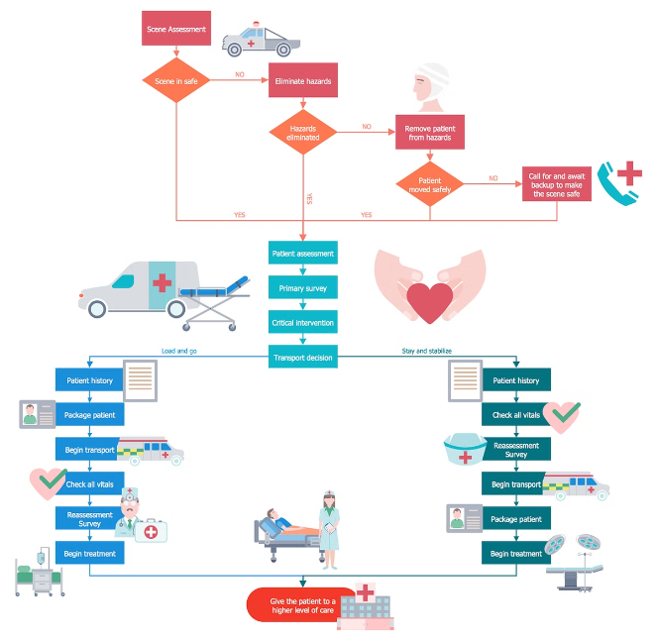
Data Sources & Ethical Considerations
Data for training and validating the model will be obtained from various sources, including electronic health records (EHRs), wearable devices, and patient surveys. Data privacy and security are of utmost importance, and appropriate safeguards will be implemented to protect patient information. Ethical considerations include data anonymization, informed consent, and ensuring responsible use of the model.
Data Source
Description
Ethical Considerations
EHRs
Electronic health records provide valuable medical history, lab results, and treatment records.
Data access agreements, anonymization, and patient consent protocols are essential.
Wearable Devices
Wearable devices capture real-time data on activity levels, sleep patterns, and physiological parameters.
Data privacy policies, consent mechanisms, and data aggregation practices are critical.
Patient Surveys
Surveys collect demographic data, lifestyle information, and personal health goals.
Informed consent, data confidentiality, and ethical survey design principles are crucial.

Slide 7

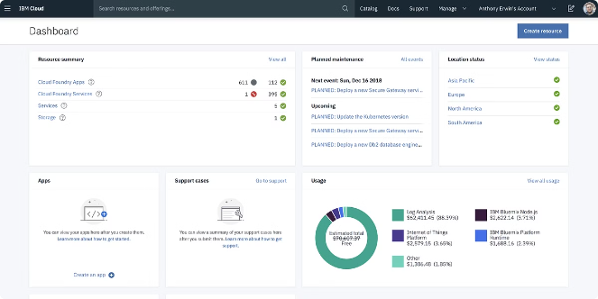



Model Deployment & Evaluation: Ensuring Real-World Impact
The trained model will be deployed on IBM Cloud, leveraging its secure and scalable infrastructure. This allows for real-time prediction and personalized recommendations for patients. The model's performance will be continuously monitored and evaluated, ensuring its effectiveness and accuracy in predicting chronic disease risk and generating relevant health recommendations.
Model Deployment
The trained machine learning model is deployed on IBM Cloud, enabling integration with existing healthcare systems and patient portals.
Real-Time Prediction
The deployed model analyzes patient data in real-time, generating predictions for chronic disease risk and personalized recommendations.
Performance Monitoring
The model's performance is continuously monitored and evaluated using metrics such as accuracy, precision, and recall, ensuring its effectiveness over time.

Slide 8






Conclusion: Transforming Healthcare with AI for Sustainable Well-being
The development and deployment of a machine learning model capable of predicting chronic disease risk and providing personalized health recommendations holds significant promise for improving patient outcomes and promoting sustainable well-being. By leveraging the power of AI, we can empower healthcare professionals with advanced tools to address the rising burden of chronic diseases and create a healthier future for all.
Early Detection & Prevention
Enable timely interventions and lifestyle modifications to potentially prevent or delay the onset of chronic diseases.
Personalized Healthcare
Deliver tailored recommendations based on individual patient data, maximizing treatment efficacy and improving patient compliance.
Empowered Healthcare Professionals
Provide healthcare professionals with a powerful tool to predict chronic disease risk and generate personalized health recommendations.
Sustainable Health System
Contribute to a more efficient and sustainable healthcare system by promoting early detection, prevention, and personalized care.

